Slide 1
Representation Learning --A Review
Jacky Jiang
adapt
2013.4.3

Slide 2
Outline
Introduction
Motivation
Representation learning
Deep learning
Summary

Slide 3
Introduction
Representation learning
Definition
Methods of learning transformations of the data that make it easier to extract useful information when building classifiers or other predictors.

Slide 4
Introduction
Deep learning
Definition
Specific representation learning methods with deep hierarchical architecture models.

Slide 5
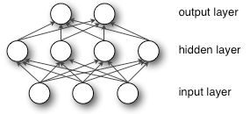
Introduction
The computations involved in producing an output from an input can be represented by a flow graph:
Depth: the length of the longest path from an input to an output.

Slide 6
Outline
Introduction
Motivation
Representation Learning
Deep Learning
Summary

Slide 7
Motivation
Curse of dimensionality
Learning complexity grows exponentially with linear increase in the dimensionality of the data.
Feature extraction
Feature extraction is the process of dimensionality reduction. It has become a significant part of artificial intelligence.

Slide 8
Motivation
The success of machine learning algorithms depends on data representation.
Deep architectures can compactly represent a significantly larger set of functions than shallow networks.
Deep architectures can potentially lead to progressively more abstract features at higher layers of representations
The brain has a deep architecture

Slide 9
Outline
Introduction
Motivations
Representation learning
Deep learning
Summary

Slide 10
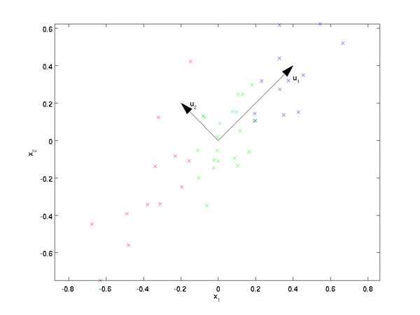

Representation learning
The oldest feature extraction method
PCA: A linear transformation $h=W^{T}x+b$.
$W$ form an orthogonal basis for the $d_{h}$orthogonal directions of greatest variance in the training data.

Slide 11
Representation learning
Within the representation learning, there has developed two parallel lines of inquiry, according to hidden units considered as:
Computational nodes;
Rooting in neural networks
-the auto-encoder variants.
Latent random variables
Rooting in probabilistic graphical models
- the restricted Boltzmann machine

Slide 12
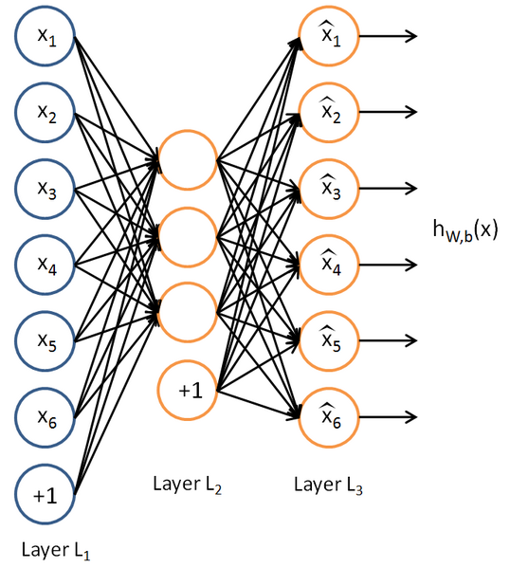
Representation learning
Auto-Encoder
An auto-encoder neural network is an unsupervised learning algorithm that applies back-propagation, setting the target values to be equal to the inputs.

Slide 13

Representation learning
Sparse Auto-encoder
We think of a neuron as being active if its output value is close to 1, or as being inactive if its output value is close to 0.
If we impose a Sparsity constraint $(\hat{ρ_{j}} is closed to 0)$ on the hidden units, their activations must mostly be near 0.
$$\hat{ρ_{j}}=\frac{1}{m}\sum_{i=1}^{m}{[{a_{j}^{}}_{}^{(2)}]}$$

Slide 14
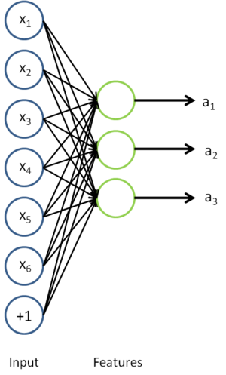
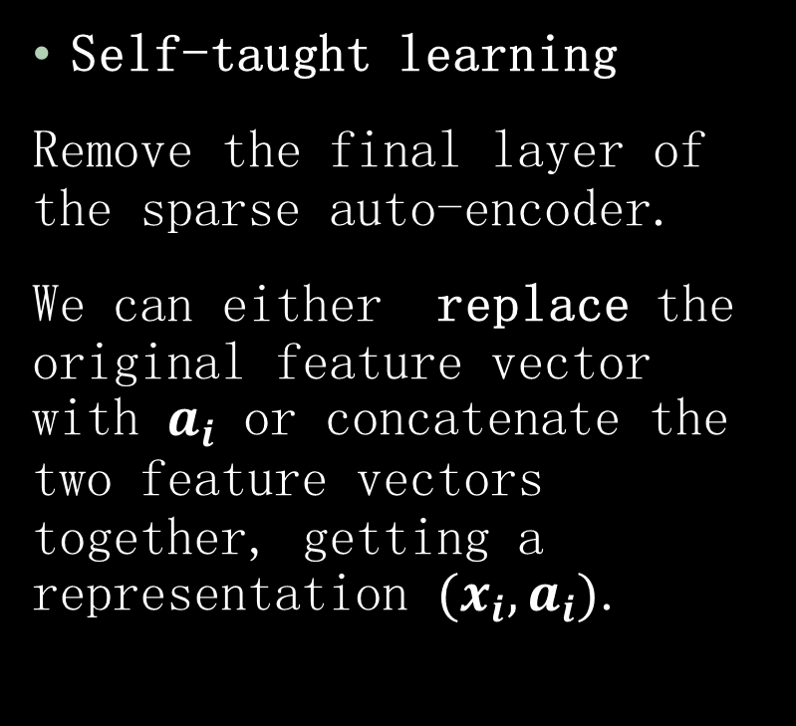
Representation learning
Self-taught learning
Remove the final layer of the sparse auto-encoder.
We can either replace the original feature vector with $a_{i}$ or concatenate the two feature vectors together, getting a representation $(x_{i},a_{i})$.

Slide 15
Representation learning
Restricted Boltzmann Machines
A Boltzmann machine (RBM) is a stochastic recurrent neural network that can learn a probability distribution over its set of inputs.
The units of RBM can follow any exponential family of distributions. If the hidden units are sufficient enough, RBM can express any discrete distribution.

Slide 16
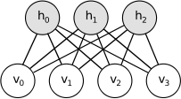

Representation learning
Restricted Boltzmann Machines further restrict BMs to those without visible-visible and hidden-hidden connections.
The energy function of an RBM is defined as:
$$E\left(v,h|θ\right)=−a^{T}v−b^{T}h−h^{t}Wv$$

Slide 17
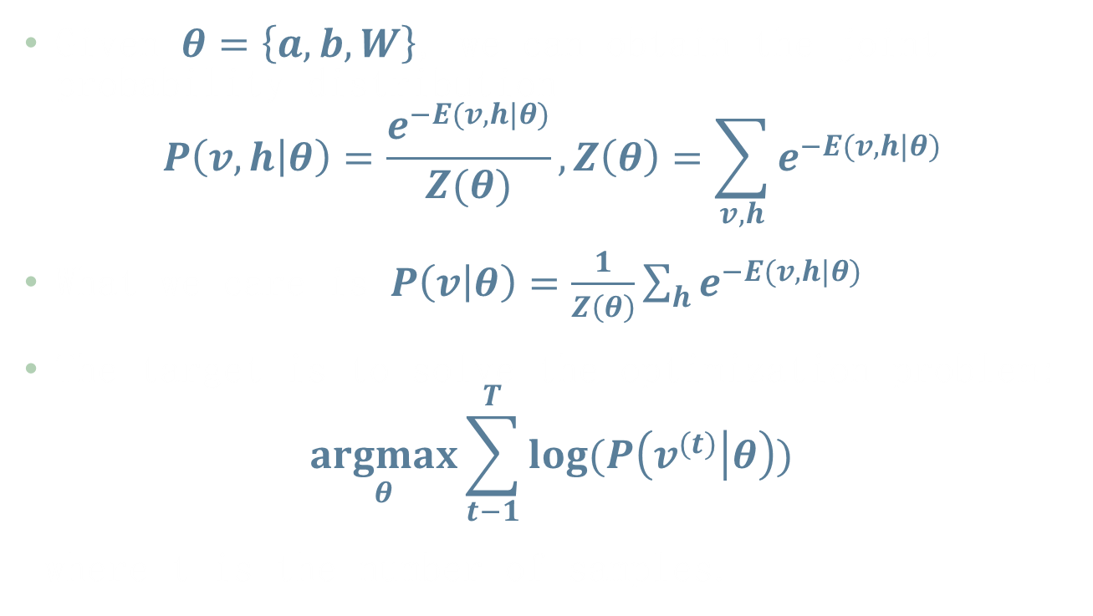
Representation learning
Given $θ=\left\{a,b,W\right\}$, we can obtain the joint probability distribution
$$P\left(v,h | θ\right)=\frac{e^{−E(v,h|θ)}}{Z(θ)}, Z\left(θ\right)=\sum_{v,h}{e^{−E(v,h|θ)}}$$
What we care is $P\left(v | θ\right)=\frac{1}{Z\left(θ\right)}\sum_{h}{e^{−E(v,h|θ)}}$
The target is to solve the optimization problem:
$$\underset{θ}{argmax}{\sum_{t−1}^{T}{log⁡(P\left(v^{(t)} | θ\right)})}$$
where t is the number of samples.

Slide 18
Outline
Introduction
Motivation
What makes a good representation
Representation Learning
Deep Learning
Summary

Slide 19
Deep learning
Hinton, A fast learning algorithm for deep belief nets
Unsupervised learning of representations is used to train each layer.
Unsupervised training of one layer at a time, on top of the previously trained ones. The representation learned at each level is the input for the next layer.
Use supervised training to fine-tune all the layers.

Slide 20
Deep learning
Deep Auto-encoder
A neural network consisting of multiple layers of sparse auto-encoders.
The outputs of each layer is wired to the inputs of the successive layer.

Slide 21
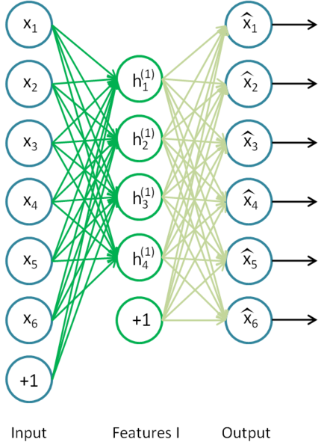
Deep learning
Step 1:
Feed the raw input into a trained sparse auto-encoder, obtaining the primary feature activations h^{(1)(k)} for each of the inputs x^{(k)}.

Slide 22
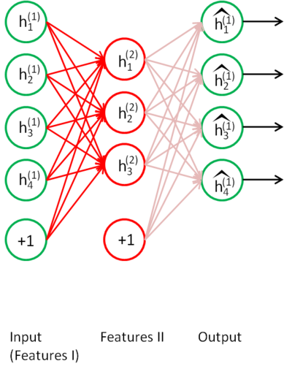
Deep learning
Step 2:
Feed the primary features into the second sparse auto-encoder to obtain the secondary feature activations h^{(2)(k)} .

Slide 23
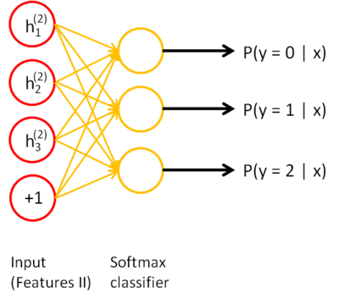
Deep learning
Step 3:
Treat these secondary features as input to a classifier, training it to map secondary features to digit labels.

Slide 24
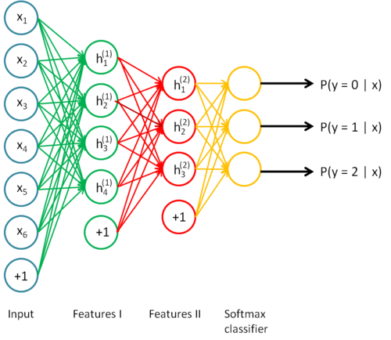
Deep learning
Overall

Slide 25
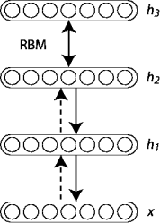

Deep learning
Deep Belief Networks
RBMs can be stacked and trained in a greedy manner to form so-called Deep Belief Networks (DBN).
DBNs model joint distribution between observed vector $x$ and the hidden layers $h^{l}$.
$$P\left(x,h^{1},…,h^{l}\right)=\left(\prod_{k=0}^{l−2}{P\left(h^{k}|h^{k+1}\right)}\right)P\left(h^{l−1},h^{l}\right)$$

Slide 26
Deep learning
Deep Belief Network algorithm
1. Train the first layer as an RBM that models the raw input as its visible layer.
2. Use that first layer to obtain a representation of the input that will be used as data for the second layer.
3. Train the second layer as an RBM, taking the transformed data as training examples.
4. Iterate (2 and 3) for the desired number of layers.
5. Fine-tune all the parameters of this deep architecture with respect to a supervised training criterion

Slide 27
Outline
Introduction
Motivation
Representation learning
Deep learning
Summary

Slide 28
Summary
Motivation of good representation
Representation learning
-Auto-encoder
-Sparse auto-encoder
-Self-taught learning
-Restricted Boltzmann machines
Deep learning
-Deep Auto-encoder
-Deep Belief Network

Slide 29
Summary
Thanks!

